Slide 1
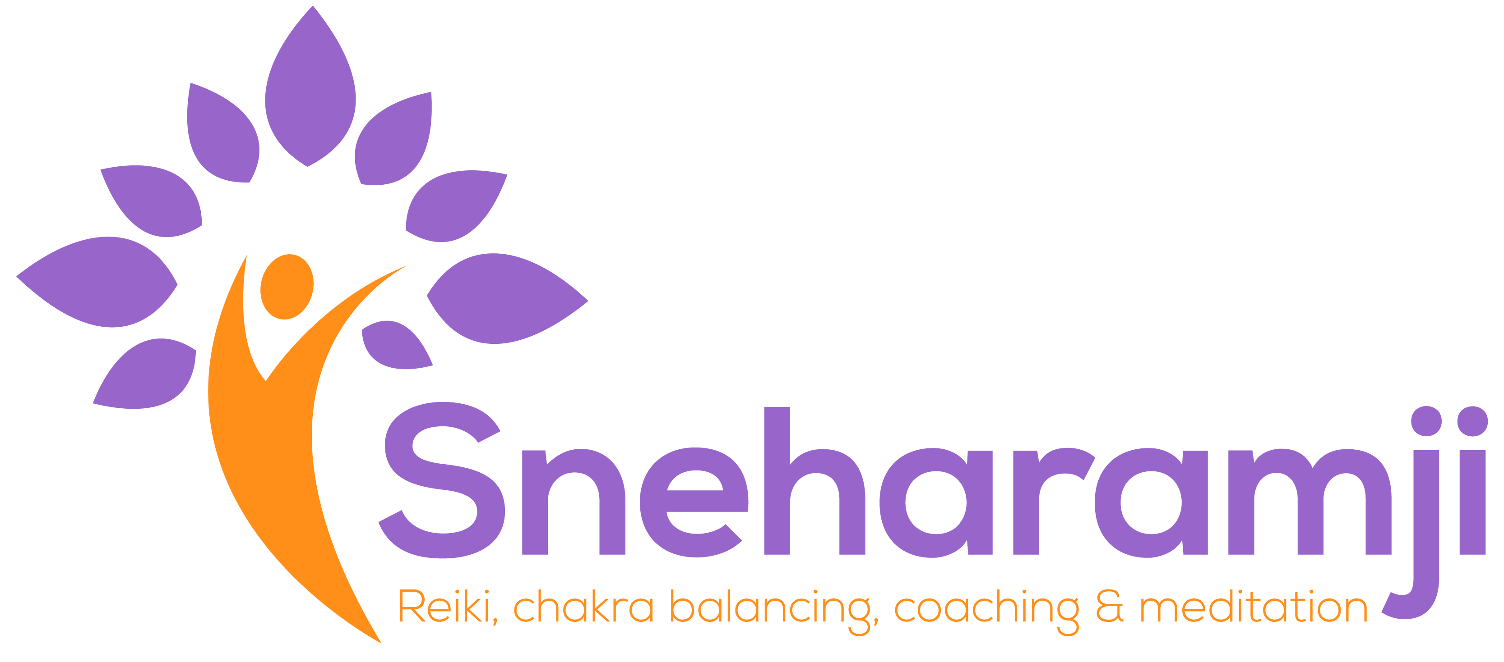
Reiki ii Manual

Slide 2
Course Content:
REIKI II Introduction
Course Outcome
Cho Ku Rai
Drawing Cho Ku Rei
Uses for Cho Ku Rei
Sei He Ki
Drawing Se He Ki
Uses for Se Hei Ki
Hon Sha Ze Sho Nen
Drawing Hon Sha Ze Sho Nen
Uses for Hon Sha Ze Sho Nen
Attunement
Reiki client guide
Various ways to heal
Appendix
Styles of healing
Subtle bodies
Reiki Principles, Chakras plus Grounding
Reiki Prayers
Client Process
Client Guide

Slide 3
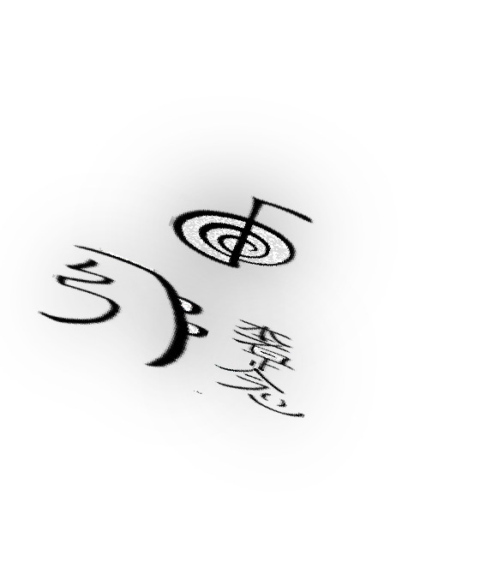
Reiki II
In Reiki II, we build on the knowledge on Reiki I and move away from touch Reiki into the use of powerful symbols.
The symbols can be activated either by visualizing them mentally, drawing the symbol with the palm of your hand, speaking the name of the symbol out loud, or simply invoking it in your mind.
In Reiki Level II you learn the following:
The distant symbol – This symbol is used to transcend time and space. This will enable you to heal others without touch.
The power symbol – This Symbol activates all of the other symbols.
The Emotional symbol - this is the emotional and mental healing symbol
Learn more on the Chakras
After this course you will be able to heal:
Remotely from a distance
From a photograph
From voice vibration
Heal emotion and mental issues.
Heal Plants, Food, situations.
Send healing back or forward in time
Work with animals in need of Reiki at a safe distance

Slide 4
Cho Ku Rei “Placing all the Powers of the universe Here”
Cho Ku Rei
The Power symbol – without this symbol it’s not possible to move from Reiki I to Reiki II. This gives power to the symbols.
Cho Ku Rei (Show-Koo-Ray) Cho Ku Rei (CKR) is the Reiki power symbol.
Cho Ku Rei has the following meaning:
Cho – To remove illusion in order to see truth
Ku– To penetrate
Rei – Universal, present everywhere
Cho Ku Rei
Magnify Reiki energy
Focus Reiki energy
Send Reiki energy to objects
Send Reiki energy to multiple people at a time
Shorten your Reiki sessions

Slide 5
Cho Ku Rei Uses
The CKR turns on the second degree Reiki energy.
Cho Ku Rei activates all of the Symbols and is the stepping stone from Reiki to II
Also known as the power symbol, it enhances the symbols and is used as a sandwich between all symbols.
Cho Ku Rei can be used to clear energies in your home
Cho Ku Rei can be used for protection on all levels - physically, mentally and emotionally
Drawing Cho Ku Rei
Draw a horizontal line from left to right.
Draw a vertical line from top to bottom.
Draw two and a half decreasing circles finishing on the vertical line as shown
.

Slide 6
Examples of Cho Ku Rei in Use
Draw it in front of yourself or around yourself to make a protective shield which will protect you from all sorts of negative energies.
Draw on Food to remove harmful effects of chemicals
Prevent yourself and your family from the harmful rays of TV, Microwave, Mobile and other such gadgets by drawing Cho Ku Rei over them.
Charge water using Cho Ku Rei
Draw it on the walls, ceilings, floor, corners, doors and windows of your home or work area to clear away all the harmful stagnant energies and purify them with positivity and abundance.
Draw it on your property to keep it safe and protected.
Draw Cho Ku Rei over your chakras to remove the blockages from them so that they can easily receive positive energy and higher guidance.
The palm of our hands carries many small chakras. Hence when we draw Cho Ku Rei on our palms, it clears the blockages, activates the minor chakras and amplifies the Reiki energy. So draw Cho Ku Rei on your palm, before you take Reiki for yourself and even before you give or send Reiki to others.
Cho Ku Rei helps to build confidence, contributes in reducing feelings of depression, anxiety, fears etc.
You can cleanse and charge your crystals and stones using Cho Ku Rei.
Cho Ku Rei used with Sei He Ki can clear and heal money related blockages, whereas Cho Ku Rei used with Hon Sha Ze Sho Nen can clear financial issue of your past and previous life as well. Drawing Cho Ku Rei on your finance related things like cheques, debit/credit cards, wallets, jewellery, cupboard safe etc with an intention to create abundance.
Draw CKR on your Reiki box to help manifest the intentions faster.

Slide 7
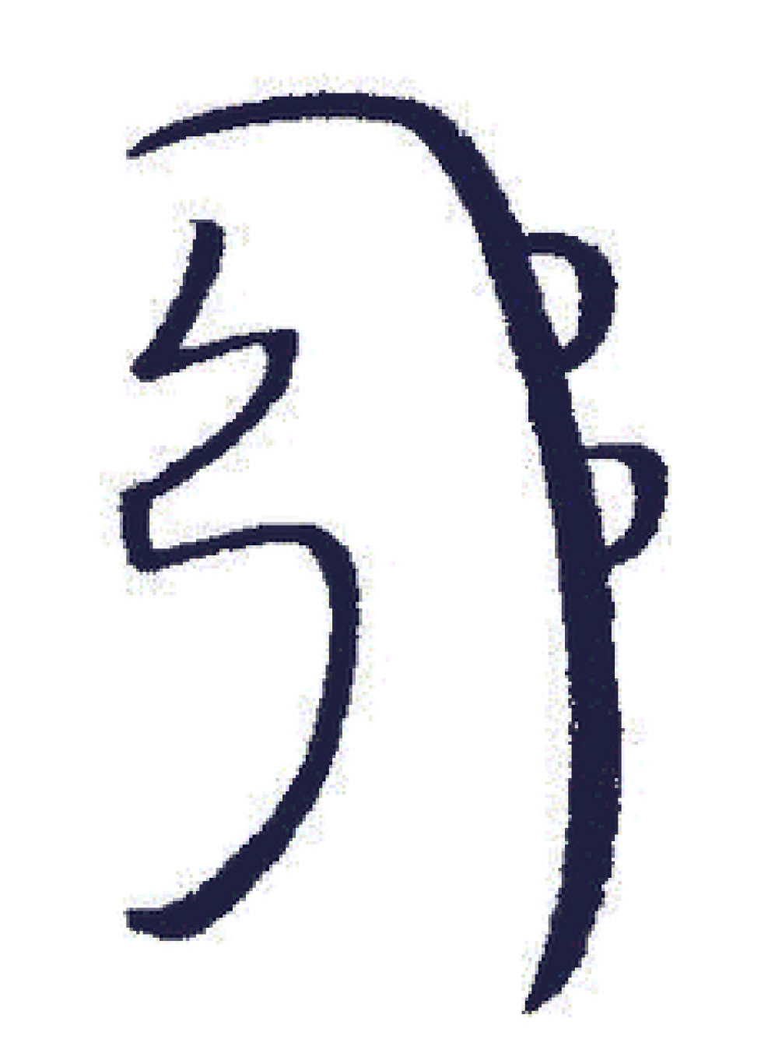
Sei He Ki "God and man become one".
Sei He Ki
This symbol acts on a person’s conscious mind (the mental body) and subconscious mind (emotional body)
The Mental/Emotional symbol brings together the "brain and the body". It helps people to bring to the surface and release the mental/emotional causes of their problems.
Sei means birth or coming into being
He Ki means balance or equilibrium.
Drawing Sei He Ki
Drawing Sei He Ki 1. Draw the first zig-zag line as shown above. 2. Now, draw a long downstroke to the right of the zig-zag. 3. Finish by drawing two semi-circles along the line. Activating Sei He Ki

Slide 8
Sei He Ki Uses
It can be used to find lost items. Imagining that the missing item/s has been found. Draw Sei Hei Ki, repeat it verbally three times and thank Reiki for helping you find what you were searching for. Eg. "I am so glad that I have found my cupboard keys. Thank You, Reiki!“ you will soon have an idea where your missing item has gone.
Use Sei Hei Ki to get rid of addiction of alcohol, smoking, drugs or any other vices. Draw the symbol on the root chakra and sacral chakra of the person and do the healing.
Sei He Ki can be used for weight loss. Start healing with this symbol and mentally visualize that millions of this symbol are coming to you or your client from the universe with light. Each symbol is bringing towards you more emotional balance and healing all the negative emotions and replacing them with positive ones.
Sei He Ki symbol is also known as the symbol of balance and harmony. The Sei He Ki symbol helps in balancing the two hemispheres of the brain. The left brain, which works on reasoning, rational and logical ideas and the right brain, which works on imagination, intuition and feelings.
As Sei He Ki is a mental and emotional symbol, it can obviously be helpful for memory improvement. Draw the symbol on the pages you want to remember or invoke Reiki before and after reading.

Slide 9
Hon Sha Ze Sho Nen "No past, no present, no future"
Hon Sha Ze Sho Nen (On-SHAW-ze-SHOW-nen) Hon Sha Ze Sho Nen (HSZN) is the Reiki distance healing symbol. It can also mean “The Buddha in me contacts the Buddha in you”.
The Distance symbol can, as its name implies, be used to send energies over a distance. Time and distance is no problem when using this Reiki symbol. Many practitioners consider Hon Sha Ze Sho Nen as the most useful and powerful symbol. The use of the symbol gives access to the "Akashic Records", the life records of each soul and can therefore be used in karmic healing. Trauma and other experiences from this life, previous or parallel lives that affect and mirror peoples' behaviours can be brought to light and released.
HON - The centre, the source, the beginning
SHA - Shining
ZE - To walk in the right direction
SHO - The goal, aim, honest being
NEN - Silence, to be open in the deepest being of your nature.

Slide 10
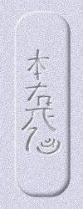
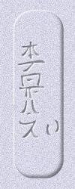
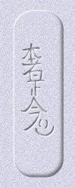
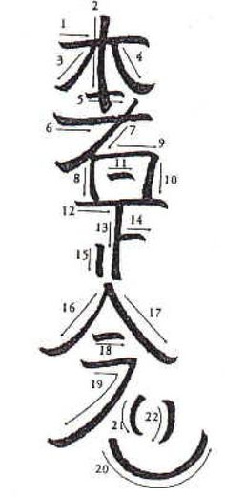
Different Ways of Drawing Hon Sha Ze Sho Nen
Essential Reiki
Traditional Reiki
Variant
Drawing Hon Sha Ze Sho Nen

Slide 11
Uses of Hon Sha Ze Sho Nen
Hon-Sha-Ze-Sho-Nen has four related and overlapping uses.
First, it sends Reiki through space and thus is used in all distant healing.
Second, it sends Reiki through time and thus is used in all past and future life healings.
Third, it works primarily on the mental body (the conscious rather than the unconscious mind)
Forth, it a door to the Akashic Records and thus used for identifying and releasing Karmic debts
Reiki can travel across time and space. You can send Reiki to friends or relatives abroad, or clients abroad.
Send HSZSN to the past to heal your old wounds
Similarly, HSZSN can be sent to future will store Reiki energy so that you can use it when you actually need it in future. Eg. Sending Reiki before giving a talk will help you to be confident and tackle any unexpected questions easily.
There are no particular rules as to how exactly should you send or use distant Reiki. It works on your intention and visualisation. Visualise the person being cured, visualise him/her being happy and pain-free.
It is believed that HSZSN also helps in karma healing and has a direct effect on Root chakra and Sacral chakra.
It gives access to life records of the soul, 'Akashik records' and hence one can heal traumas of past lives as well.

Slide 12
Attunement
Attunement is similar to Reiki I, you have to sit with your eyes closed and be silent.
You have to be open to receive healing and level II symbols.
It’s good to feel blessed and grateful as you go into an attunement.
It’s also beneficial to go in after doing a short grounding exercise.
You would have been notified but it’s good to have your system clear of recreational drugs, alcohol or dairy. This allows the energy to pass more freely.
In the attunement you will be asked to move your hands and also be touched on the head.
In the attunement, you may experience tingling, feeling hot or cold, a feeling of floating out of your body, seeing intense colours and ascended masters, power animals, Devas and all manor of things. This is all normal. You may not experience anything, this does not mean the attunement did not work. People experience it in different ways. If you feel uncomfortable at any point ask the practitioner to stop. This rarely happens but it’s there for you if you need to.
Try not to compare your experience with the people in your group, as we all on individual journeys. You don’t know your path compared to theirs. Although there would have been a reason you were brought together in this group to learn the reiki. The path is very individual. People progress and develop at their own pace.
After the attunement, you will get some quiet time to process the energy, we advice that you sit alone without any interruptions for 5 to 10 mins refraining from looking at your phone.
Have plenty of water during the day and the following week. By having an attunement, you are clearing your own chakras so you need to be gentle with yourself. Emotions may surface as well old feelings. Again this is natural. You may also have a sore throat or a cold. If the symptoms get too much then contact us.

Slide 13
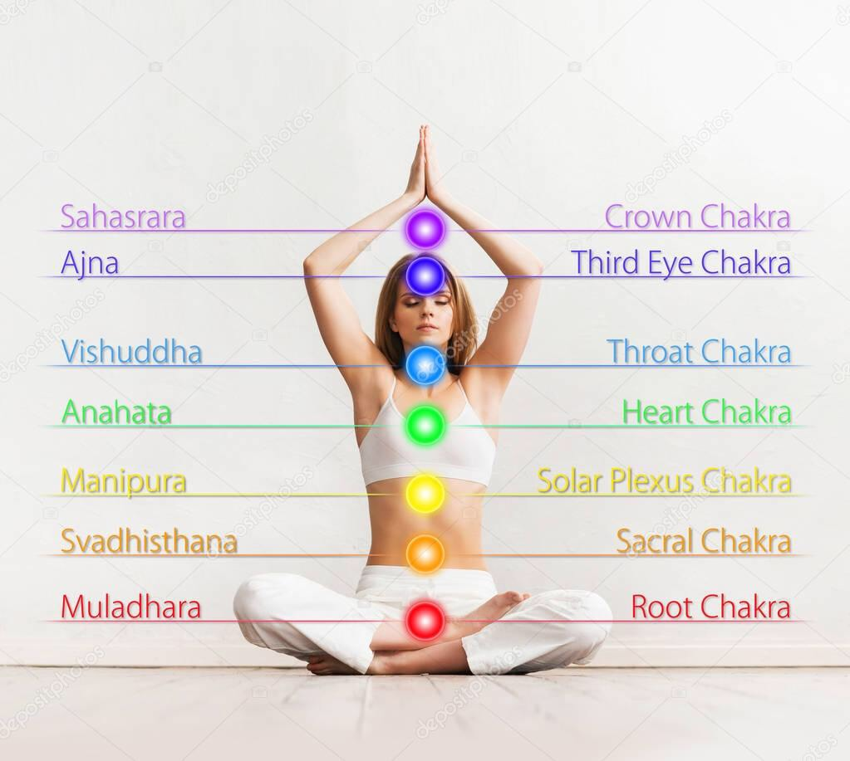
Reiki II Information
Reiki Principles
Just for today, I will not anger. I will not worry. I will be grateful for my many blessings. I will be kind to all living creatures.
Location of the Chakras
How to Ground Yourself
Close your eyes, imagine your feet are feeling warm and heavy. Imagine you have roots like an oak tree coming from the bottom of the feet into the ground. Allow the roots to go wider and deeper. Really feeling the energy of the planet and feeling grounded. You can now open your eyes.

Slide 14
Reiki II Healing
Opening Prayer
I thank God for being here I think Reiki for being here I thank [your name] for being here I thank the client for being here. I cover myself and the client with divine white light.
Closing Prayer
I thank God for being here I think Reiki for being here I thank [your name] for being here I thank the client for being here. I thank the white Light I thank each of the Symbols used by naming each one. I thank DR Usui, the linage of Reiki, teachers.

Slide 15
Reiki II Process
Step 1 Check List
Clean your space – Smudge and declutter Disclaimer form completed Make sure that this is an appropriate treatment for the client Explain to the client the process If touch reiki then ask permission to touch. Give them option to stop during the session if they need to.
Step 2 Open the Healing
Do your grounding Say your opening prayer Set your intention for the client Draw Hon Sha Ze Sho Nen Draw Se He Ki Draw Cho Ku Rei
Step 3 Chakras
Start with the Third Eye chakra and visualise the healing going to the third eye Draw CKR +SHK +CKR on each charka Work your way down through the chakras approx. 3 mins per Chakra Go back to a chakra you felt needed more healing.
Step 4 Closing
Finish the Reiki by saying closing prayer In your mind wash your aura with white light Ask client what they felt Give them feedback be careful to do it sensitively Give them aftercare tips and rebook the next session if needed Cut the cord with the client three times by the motion of the hand Once the client has left, smudge the area and wash your hand

Slide 16
What is Attunement?
The Attunement is an initiation into Reiki.
It a form of a blessing and clearing of the chakras in order to receive source energy.
What to Expect:
Sit comfortably and up straight. Palms should be on your thighs facing up. Set an intention on what to expect from the attunement. Ie to develop a deep connection to Reiki energy in order to help yourself and others.
Put your hands in the Gassho position when you are tapped three times on the shoulder.
Your hands will be open and closed and we blown onto your little finger and thumb.
We will blow on your third eye, heart and stomach (hara)
When this is finished you may move your hand back to your thighs.
At the end in your mind say thank you for the process. There will no talking and take 5 mins of silence after the attunement to let it the energy sink in.
We will then share to the group individual experience. The journey into reiki is very individual so nothing may happen during the attunement process. This doesn’t mean it has not worked it may just take time to bed in.

Slide 17
Reiki Client Guide
You must be able to do the following:
Evaluate requests for complementary and natural healthcare and take the appropriate action
Explain the nature of the service and fee structures to the client
Provide an appropriate and safe environment for the service
Make clients feel welcome and ensure they are as comfortable as possible
Discuss the client’s needs and expectations, and ask relevant questions
Encourage the client to ask questions, seek advice and express any concerns
Establish the client’s needs in a manner which encourages the effective participation of the client and meets their particular requirements
Determine any contra-indications or restrictions that may be present and take the appropriate action
Evaluate the information obtained and determine the appropriate action with the client
Complete and maintain records in accordance with professional and legal requirements

Slide 18
Reiki Client Guide
First Steps
Get Insured, recommend Balens or Towergate insurance. Get registered with the UK Reiki Federation Start on Friends and Family Set your prices – charge slightly less than market value but increase to market value with experience. Value your training and time spent. You may want to be flexible with this, if a person is hard up or very sick. Again there should be a reciprocal energy exchange. This does not apply to the very sick or accident victims.
Client Rules
Make sure you have permission If you are doing touch reiki, make sure the client is comfortable with it and boundaries and where touch is administered have been communicated to the recipient. Get them to sign a waiver Get them to sign GDPR Ask them what they expect from a session Explain the process to them what they will experience Give them after care advice: Drink more water, take a walk in nature, Epsom salt Bath. They may experience dizziness, headaches, emotional release.
Reiki principles to follow
Always have permission Law of reciprocation – make sure there is a fair exchange for reiki administered. Make sure you make it clear that it’s not a substitute for medical attention or counselling. It’s a complementary therapy. If they confide in you any criminal activity then you are bound to report it by law. If it’s a child under 18, you must have a guardian in the room unless you are cleared to work with children. With DBS check and various other checks.

Slide 19
Reiki Guide
Reiki principles to follow
6) If the client is likely to harm themselves or others then you have to report it to the police. 7) If you are treating a pet you have to have permission from the owner. 8) You can treat an emergency case with out permission 9) You can treat blood relative or someone whos having a direct impact on your life like a husband or boyfriend. Even then it’s best to obtain permission 9) If the client is needing emergency treatment then you should phone the emergency services 10) You can refuse to give treatment if you are ill, tired or the client is being disrespectful, is asking you to prove the treatment and not giving you any information if the client has taken alcohol or drugs. 11) Special care needs to be taken with the elderly, the dying, children, pregnant women. 12) You cannot give reiki to someone with a pace maker 13) Reiki can sometimes make a pain worse before it gets better. In this case you have to advice the client to go to medical care. The important thing is not to panic. You can check up the patient in a few days to check on their condition.

Slide 20
Various way to Heal
Remotely from a distance – Now that you are level ii, you can use the distance symbol to connect you to people all over the world. There is no need for touch. You will need something of the person to connect to their energy. Having their prior permission still applies.
From a photograph – you can use a picture of them to connect to their energy and ascertain which charkas are out of balance and where to direct the energy.
From voice vibration or video call. Sound has a frequency, you make a connection using HZSN.
Heal emotion and mental issues using SHK
Heal Plants, Food – make sure these are ideally in glass or plastic containers. You would start the reiki flow as per normal. Set your intention for the plant to grow for the food to be cleared of any consciousness or toxins. Then channel the reiki to change the molecular structure of the food.
Send healing back or forward in time - you can set up the reiki using intention to travel in time. You can send reiki to interview or a journey. Back in time you can send to particular trauma or events in the clients life that still have an emotional pull for the client.
Work with animals in need of Reiki at a safe distance – you can send animals reiki however always best to ask the owner unless you see them in distress.

Slide 21
Reiki Client Questionnaire Assessment
Prior to meet you should send the following:
1) The disclaimer below, this will ask how if the client has ay health issues or is on meditation or care of a medical professional
It also points out that that is the first point of call and reiki is not a replacement for medical or phycological care.
2) Ask what they expectations are of the session
3) Ask how committed they are to healing? It may seen like a daft question but some people are either used to the illness or aren’t willing to take responsibility for their healing.
4) Ask them if they have any concerns regarding the session?

Slide 22
Reiki Client Information Form Example:
Date:
Name_____________________________________________ Phone: ________________
Address:________________________________________________________________________________________________________ Email _______________________________________________
Emergency Contact: _____________________________________________
Current Medications____________________________________
Are you under the care of a doctor or hospital? ____________________________________
How did you hear about us? ____________________________________
Have you ever had a Reiki session before? __Yes __No
If yes, when was your last session? ____________ Number of previous sessions
I understand that Reiki is a simple, gentle, energy technique that is used for stress reduction and relaxation. I understand that Reiki practitioners do not diagnose conditions nor do they prescribe or perform medical treatment, prescribe substances, nor interfere with the treatment of a licensed medical professional. I understand that Reiki does not take the place of medical care. It is recommended that I see a licensed physician or licensed health care professional for any physical or psychological ailment I may have. I understand that Reiki can complement any medical or psychological care I may be receiving. I also understand that the body has the ability to heal itself and to do so, complete relaxation is often beneficial. I acknowledge that long term imbalances in the body sometimes require multiple sessions in order to facilitate the level of relaxation needed by the body to heal itself.
I would like to join the Facebook community/Whats App community to receive free articles and updates. Yes/No or you can specify medium of contact.
I like to receive newsletters from Sneha Ramji Yes/No. Please refer to the privacy policy on our website
Signed: ________________________________ Date: _________________
Privacy policy: No information about any client will be discussed or shared with any third party without written consent of the client or parent/guardian if the client is under 18.

Slide 23
Reiki Client Guide Assessment
In the session
In order to assess the client and come up with the best way forward. First thing is to consult with the client.
Ask them why they came to see you and what they expect from the session. Explain to them the limitations of reiki.
Explain what they can expect from the session as well as how they will feel afterwards
Once you know the issue then you can access which chakra this issue relates to using the chart below
Chakra | Functions of the Body
Root chakra | Blood, foot, skeleton, bone, legs, nails, anus, rectum, colon, prostate, and building of cells
Sacral chakra | Kidney, urinary bladder, reproductive system, ovaries, sperm, female cycle.
Solar Plexus | Pancreas, digestive system, large Intestine, liver and lung
Heart chakra | Heart, lung and circulatory system, upper back, arms, shoulder pains and the skin
Throat chakra | Thyroid, oesophagus, teeth, neck, shoulder, mouth, trachea and facial problems
Third Eye chakra | Head, eye or vision, back of the head, hormone function, pituitary gland.
Crown chakra | Nervous system, pineal and pituitary gland

Slide 24
Reiki Client Guide Assessment
You will follow the process of healing all of the chakras but this will help you to focus on the issue they came for and the intention that you need to set at the beginning of the process.
You can also scan the body if you are unsure of where to focus the healing.
Body Scanning and Reiki
You can scan the chakra as you heal
As you do all of the symbols and work your way through the chakras you will sense where the chakras are blocked or imbalanced. It’s a good idea to make a note of these and supply to the client along with an explanation.
Hand Scanning
Many will also practice body scanning through the use of their hands. You can sweep your hands across your own or someones body. You will meet a resitance on where the aura is radiating to. When you come to the boundaries your hands will feel a sensation and hard to move past most auras should come out by a few feet where the auric field is close to the body the energy is low.
Over time, you will learn to recognize where the energy is and where it is blocked. Sometimes, the energies will contrast so much that you will be able to find areas on the body that carry a different temperature than the rest of the body. These temperature differences indicate a block of energy.

Slide 25
Reiki Client Guide Assessment
Pendulums
Pendulums are another a good method for body scanning. You can move a pendulum up and down a body. It will show areas where the energy is off by not keeping the same tempo throughout the body. The pendulum should move in different directions between the different chakras. When the pendulum moves in a circular motion this is usually positive and when vertical then it shows that there is a problem with the energy in that area.
Body Energy
Body scanning will cause you to be able to notice different energy flows by the changes in energy from either your own body or from someone else. Heat and coolness is the most often sensed change in energies.
There are also sometimes occurrences of tingling, electric shocks, pulses, or pulling sensations. All of these energy changes will show you where the bodys energies are off and will show you what to do in order to change the energy flow with universal energy.

Slide 26
Reiki Client Guide Assessment
Healing Styles
We all heal differently and are able to pick up imbalances differently. The more you practice the more you will realise how to pick up on your client. What we are doing is energy work so inevitably you will form energy cords with the client, you will need to cut these at the end of the session. These will help you to read the clients energy and blockages. How you do this may vary according to your strongest sense.
Clairvoyant - (clear sight) you may be able to see blockages if you close your eyes using the third eye or colours related to the chakras
Clairaudient – (clear audio) you maybe to hear messages for your client.
Clairsentience (clear sensation or feeling) – you maybe able to feel their pain. You maybe an Empath. You may need to disconnect by asking to disconnect from the pain.
Clairempathy (clear emotion) – An Empath is a person who can psychically tune in to the emotional experience of a person, place or animal.
You will need to practice to see how your pick up information hence why you have to practice on yourself and others to get used to how you pick up information from the body.

Slide 27
Subtle Bodies
Subtle Body Energies: The Seven Subtle Bodies
There are seven subtle bodies, or layers, around the physical body, which create the aura. These are not layered in a linear fashion but overlap. As you extend inward, the one before is also present within the next aura layer. For example, the outer most body is the causal, body. The next is layer is the celestial body, which contains itself and the causal body. As you go inward, towards the first layer (the etheric) it will be the densest because it holds all seven subtle bodies. And of course, there is the physical body, which is the densest of them all.
The seven subtle bodies can be broken down as follows:
There are three bodies that exist in the physical plane, three that exist in the astral plane and the astral body, which is the bridge between the lower and higher bodies.
The lower three bodies process energies dealing with the physical plane, whereas the upper three process energies from the spiritual planes.
At this level we only concern ourselves with the first three bodies. The reason we look at these is that our emotions and thoughts are stored in these bodies and eventually will want to manifest into the physical if not cleared.

Slide 28
Subtle Bodies
First Layer (The Etheric Body) This is the closest energy body to the physical. It is what is made evident through Kirlian photography. The etheric body extends one quarter to two inches beyond the physical body
This is linked to the root chakra
Second Layer (The Emotional Body) Since this is the emotional body, it is associated with feelings. It is more fluid in nature, and does not duplicate the body, as does the etheric body. This body is about one to three inches from the physical body. Unlike the etheric body, which is blue or grayish in nature, this is more like colored clouds that change colour depending on what kind of emotions the person is going through. Love, joy, excitement, and even anger will result in very brilliant hues, whereas confused emotions will result in muddy tones.
This is linked to the sacral chakra
Third Layer (The Mental Body) With an even more subtle composition, the mental body holds our thoughts and mental processes. It extends three to eight inches from the body, and generally has a yellow light, which radiates around the head and shoulders, and extends to the body below. This yellow will brighten if a person is deep in thought, or concentrating on mental activities.
This is linked to the solar plexus chakra

Slide 29
Requirements for Level II
Practice the healing the 7 areas ( 6 chakras and one focus point) for 21 days preferably consecutively but can be spread over 6 weeks. These need to broken up into
25 x 3 min sessions
2) You also need to do 12 case studies involving friends of family members. (no strangers) you will heal the 6 chakras for 3 mins each and you will focus one weak point for 3 mis
3) One supervised session
4) Complete the below case studies.
All of the above needs to be logged and approved before you receive your certification.

Slide 30
Case Studies
Case 1
A women comes to your with Urinary tract infection
What chakras do you concentrate on?
Case 2
Someone comes to you for Anxiety.
How do you deal with it?
Case 3
Someone comes to you with breast cancer, how to you deal with it?
Case 4
Someone has got chronic upper back ache?
Case 5
Someone comes to you with a Frozen Shoulder?
Case 6
Someone has suffered a loss of a Grandmother. How do you deal with it?
Case 7
Someone comes to you with a twisted ankle. How do you deal with it?

Slide 31
Reiki Time Log (self x25)
Date | Duration | Issue | Observations | Result | Learning
5th July 2019 | 30 mins | Bad Back | The heart and sacral chakra appear to be out of balance | Client felt relaxed and pain reduced. | Pain was from an emotional upset

Slide 32
Reiki Time Log (self)
Date | Duration | Issue | Observations | Result | Learning
5th July 2019 | 30 mins | Bad Back | The heart and sacral chakra appear to be out of balance | Client felt relaxed and pain reduced. | Pain was from an emotional upset

Slide 33
Reiki Time Log (others x12)
Date | Duration | Issue | Observations | Result | Learning
5th July 2019 | 30 mins | Bad Back | The heart and sacral chakra appear to be out of balance | Client felt relaxed and pain reduced. | Pain was from an emotional upset

